Slide 1



The Impact of Mindfulness Training on Declarative Memory Performance and Microstructural Integrity of Major White Matter Tracts Associated with the Hippocampus
Elizabeth Kaplan, BS BA
Brown University
Notes:
Hi Everyone, Thank you so much for presence this morning. My name is Elizabeth Kaplan and today I am going to be presenting my senior thesis project, completed in collaboration with Dr. Sara Lazar at Mass Gen/Harvard Medical School, entitled “The impact of MT of WMP and MI of Major WM tracts associated with the hippocampus”

Slide 2
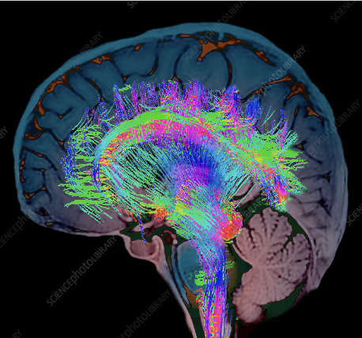
Introduction:
-Age-related white matter (WM) degradation underlies decreases in working memory performance
-The hippocampus is essential to cognitive performance
-Interventions to decelerate cognitive decline are of great interest.
Notes:
The world around us is aging - rapidly. By 2030, the worldwide population of older adults is expected to reach one billion. While this longevity can be viewed as a significant achievement of the twentieth century, significant health challenges accompany this global trend.
Our brain is composed of two distinctive tissue types. Within Gray matter, there are neural cell bodies, axon terminals, and dendrites facilitating cognitive processing. However, within this gray matter we find white matter, which is comprised of nerve fibers within mylein sheeths, also known as white matter tracts, that allow effective information transfer between different gray matter regions.
Degradation of white matter is commonly associated with healthy aging and given the pertinent role of WM in facilitating cognitive function, research has suggested that these age-related decreases in WM integrity may underlie decreases in cognitive performance, including declarative memory, as an individual ages. Interventions to decelerate cognitive decline are of great interest and given the hippocampus role in perceptual and linguistic binding, this region is likely essential to declarative memory performance and as such may be a target of interventions to decelerate cognitive decline.

Slide 3
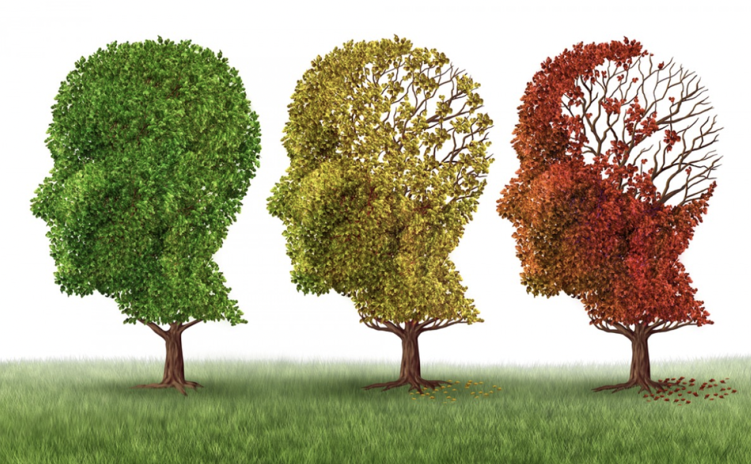
How do MBIs Impact Hippocampal White Matter (WM) Tracts in Healthy Aging?
Notes:
There has been a plethora of research which have shown both structural and functional changes within the hippocampus following MBIs, while significantly less literature has looked into the impact of MBIs on white matter within the hippocampus in the context of aging. Based on previous literature, MBIs might be an important intervention for older adults to slow age-related neural degeneration and declines in cognitive performance.
As such, I decided to pursue an investigation to look into this using data collected in the Lazar Lab which focused on healthy cognitive aging

Slide 4
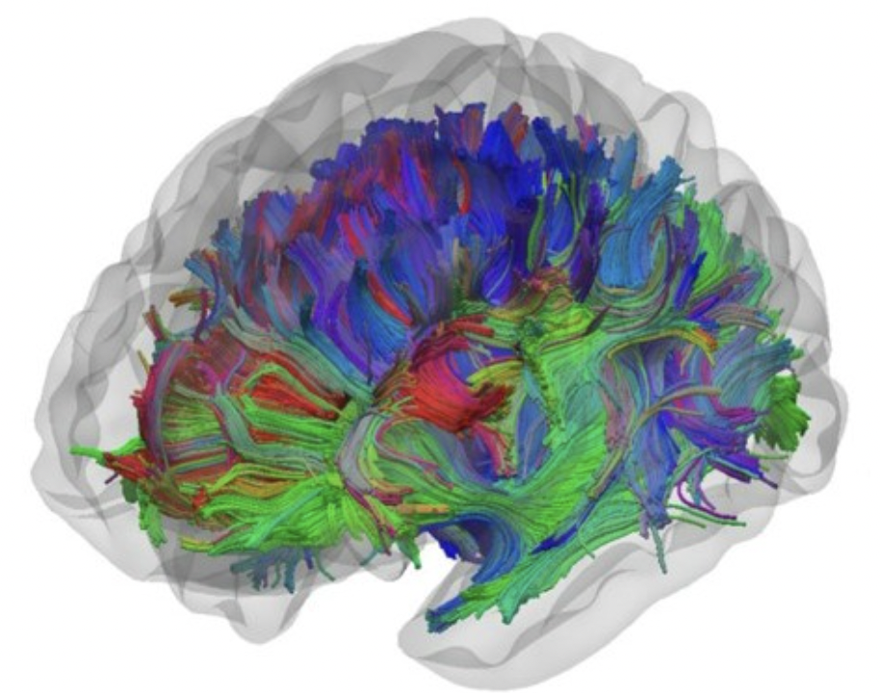
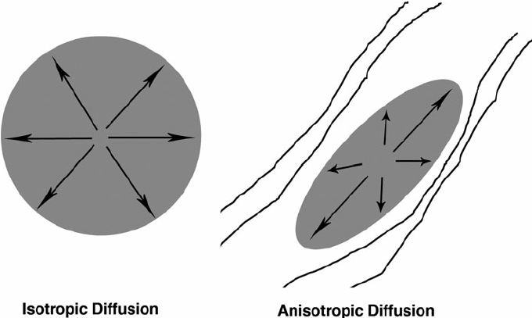
Investigating WM Integrity:
Diffusion Tensor Imaging (DTI):
Uses anisotropic diffusion to estimate axonal organization in the brain
Fractional Anisotropy (FA) - quantification of diffusion anisotropy
Notes:
In order to further understand the role of white matter integrity, specifically in the hippocampus, we can utilize diffusion tensor imaging. DTI uses anisotropic diffusion to estimate axonal organization in the brain. Essentially, this form of imaging is capturing the diffusion of water molecules within our white matter tracts Molecules will diffuse differently along different tissue types and depending on the tissues’ integrity and architecture and so DTI will provide us information about these features.
One measure that we can infer these features of WM integrity from are fractional anisotropy values which describe the rate of anisotropic diffusion within a given tract and more generally, give information about white matter microstructural integrity where Higher FA values generally indicate increased white matter integrity.
FA is thought to reflect fiber density, axonal diameter, and myelination in white matter. FA values range 0 and 1 where A value of zero indicates that diffusion is isotropic where a value of one means that diffusion occurs only along one axis and is fully restricted along all other directions.

Slide 5
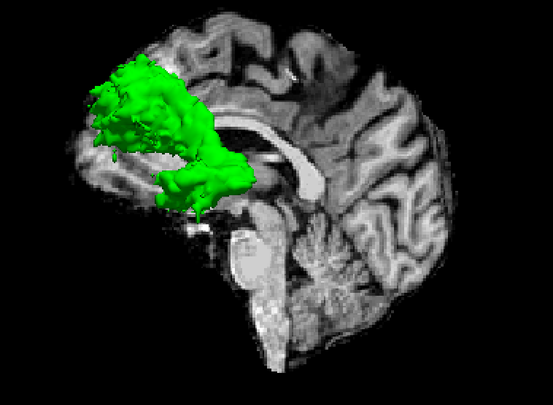
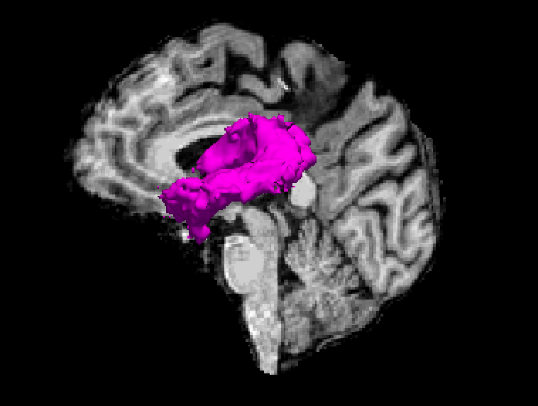
Tracts of Interest:
Uncinate Fasciculus (UF) - hippocampus/amygdala/ frontal lobes
Modifiable through MT (Hölzel,2016)
Fornix of the hippocampus - Major output of the hippocampus
Notes:
I was particularly interested in investigating the WM within two major tracts associated with the hippocampus:
The UF and fornix. The UF, labeled in this sagittal slice in yellow, is a major tract that connects the hippocampus to the amygdala and to frontal lobes. Previous literature has shown FA increases in the UF following an 8-week MT suggesting that this tract may be modifiable through MT. Furthermore, several studies, using computerized cognitive trainings have reported increases in FA within the fornix, a major output tract of the hippocampus and labeled here in pink. Research has also shown that decreases in WM integrity in this region correlate with decreases in performance on memory tasks, suggesting that this tract may be essential for cognitive performance.
A left sagittal view of pathways reconstructed automatically with TRACULA: fornix (magenta), uncinate fasciculus (UF) (yellow), dorsal portion of cingulum bundle (CBD) (teal), ventral portion of cingulum bundle (CBV). The distribution of each pathway is displayed as an isosurface over the T1 image of a randomly selected control participant.

Slide 6
Hypothesis I: Mindfulness Training will produce significant increases in Fractional Anisotropy (FA) within the Uncinate Fasciculus (UF) and Fornix of the Hippocampus.
Notes:
This leads us to my present hypothesis:

Slide 7
Study Design
138 healthy older adults (seeking brain training)
65-80 years old, cognitively normal
No prior meditation or yoga experience
Tested at baseline, end of program, and at 12 months program end
Notes:
To test this hypothesis, I used data collected in the Lazar Lab’s aging study.
*neuroimaging completed at MGH*

Slide 8

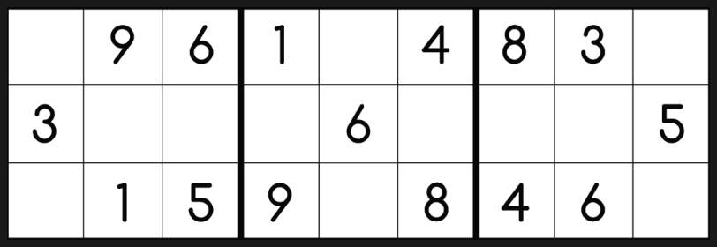
Study Interventions
Mindfulness Training
Cognitive Fitness Training
N = 47
8 wk intervention including weekly meetings and 40 minutes of daily mindfulness meditation practice
Instruction derived from MBSR but focused on cognitive enhancement, not stress reduction
N = 49
8 wk intervention including weekly meetings and 40 minutes of daily brain games (puzzles, sudoku, crosswords, etc)
Notes:
Participants were randomized to one of two groups, either the MT group or the cognitive fitness training group, which served as our active control. From the 138 subjs, 96 individuals completed DTI. So in my present analysis, I was looking at 47 individuals within the MT group and 49 in the CFT group. Both interventions lasted 8 weeks and consisted of 1 hour weekly meetings plus 40 mins of daily practice, either MM or brain games such as puzzles, sudoku, depending on group allocations. And notably, the Mt instruction was derived from MBSR …

Slide 9
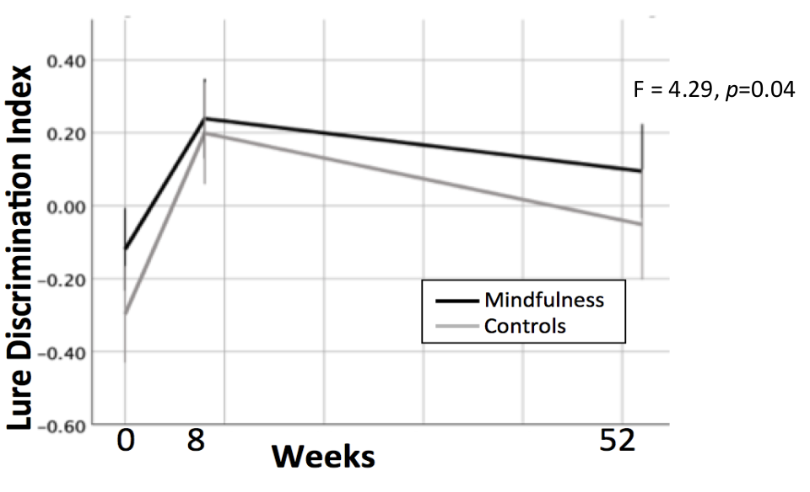
Changes in Declarative Memory (MST) Within Study Population
Herrera et al., In Progress
Notes:
Before getting into the results of my investigation, I want to first show you the results concerning the change in declarative memory which was also collected as a part of this study. We identified significant increases in declarative memory pre- to post-intervention across both groups. Notably, although both groups decreased from week 8 to week 52, the change in the mindfulness group was not significant. These changes in memory correlated with GM in the mindfulness, but not the control group. Relationships between performance on this task and hippocampal GM volumes has been well-established in other literature, as well.

Slide 10
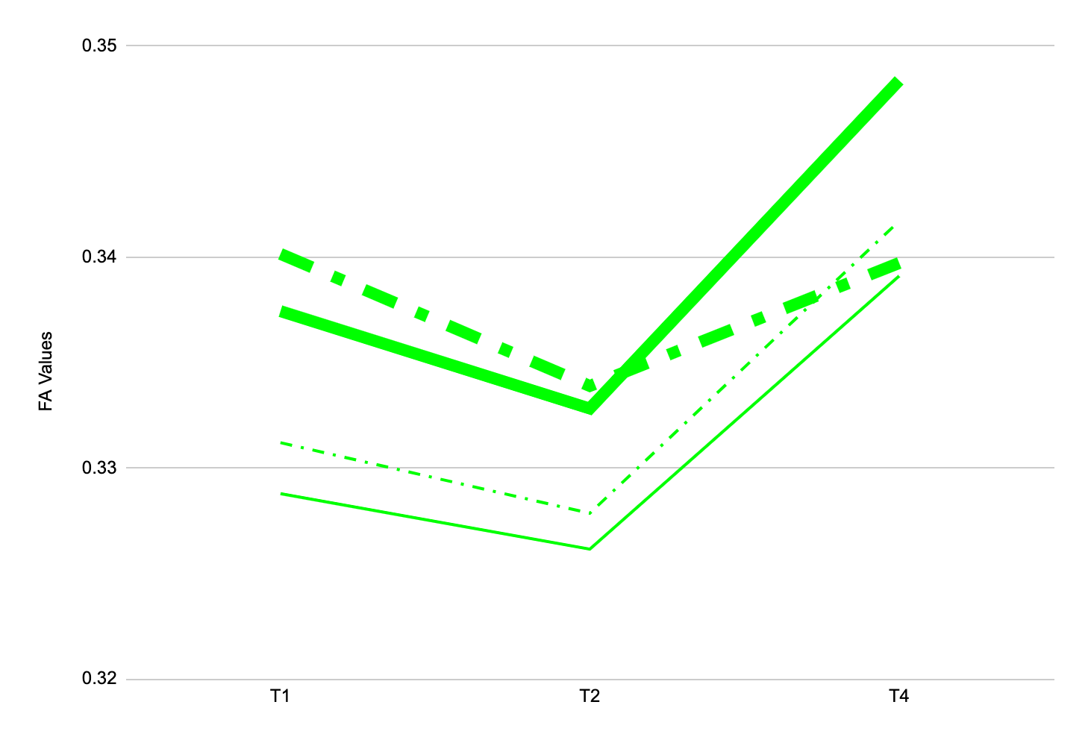
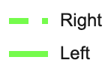
Uncinate Fasciculus
Right GxT
F = 2.77 p = 0.0662
Mindfulness
FA Values
Mindfulness
Control
Control
* Age, Practice time & Baseline FA vals controlled for
Week 0
Week 8
Week 52
Notes:
I first investigated the Uncinate Fasciculus. So to orient you to this graph, the FA values for the mindfulness group are indicated by the two thicker lines. Across both groups, FA values for the right uncinate fasciculus are indicated with the dashed line, whereas FA values for the left uncinate are indicated with a solid line. When looking at group by time interactions in the left uncinate fasciculus, I found no significant interactions both between- and within-groups when controlling for Age, Practice time, and baseline FA values. However, in the right uncinate fasciculus, the gxT interaction approached significance. In my within-group investigation, there was a significant effect of time within the controls but not the mindfulness group.
It is interesting to note the initial decrease in FA values in both the control and mindfulness groups from pre- to post-intervention, which directly contradicts my present hypothesis. However, decreases in FA following training or in highly skilled experts, such as professional athletes and musicians, compared to controls has been reported. These studies hypothesize that these decreases might be due to increased efficiency within regions of interest or due to training-induced alterations in crossing fibers. Even after one year of practice, these meditators would still be considered novice but nonetheless, due to the resolution of our scans we cannot evaluate these hypotheses in our sample and thus, these results are difficult to interpret. It is also possible that we are seeing axonal pruning which is typically followed by regrowth which would nicely explain the present trend.

Slide 11
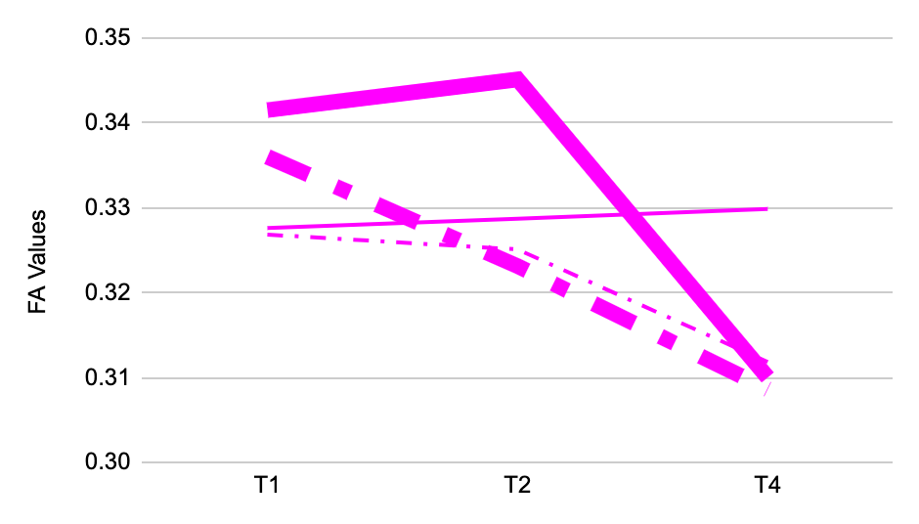
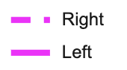
Fornix of Hippocampus
Within-Mindfulness
L Fornix : p = 0.0150
R Fornix: p = 0.0330
Mindfulness
Mindfulness
FA Values
Control
* Age, Practice time & Baseline FA vals controlled for
Week 0
Week 8
Week 52
Notes:
Now looking at the fornix of the hippocampus, There were no significant GxT interactions across either the right or left fornix. However, within the mindfulness group, there was a significant interaction between FA values and time bilaterally. There were no significant change within the control group.
We also see a decrease in FA values in this region, which might be explained by previously mentioned factors.
Another interpretation is that although it is Unlikely for deterioration pre-post but might be possible at the one year followup

Slide 12
Hypothesis II: Significant changes in FA values within the UF and the Fornix of Hippocampus will correlate with increases in measures of declarative memory.
Notes:
Given the hippocampus’ role in cognitive performance and our finding of increased scores on the MST, I was interested in investigating how these changes in White matter related to measures of working memory, which brings us to my second hypothesis: Significant changes in FA values within the UF and within the Fornix of Hippocampus will correlate with increases in measures of working memory.

Slide 13
No Relationship between FA values within the Uncinate Fasciculus and the Fornix of Hippocampus and measures of declarative memory.

Slide 14
Exploratory Investigation
Notes:
In light of these results, I was interested in pursuing an exploratory investigation in order to solidify our understanding of the role of mindfulness training on white matter plasticity in tracts associated with the hippocampus.

Slide 15
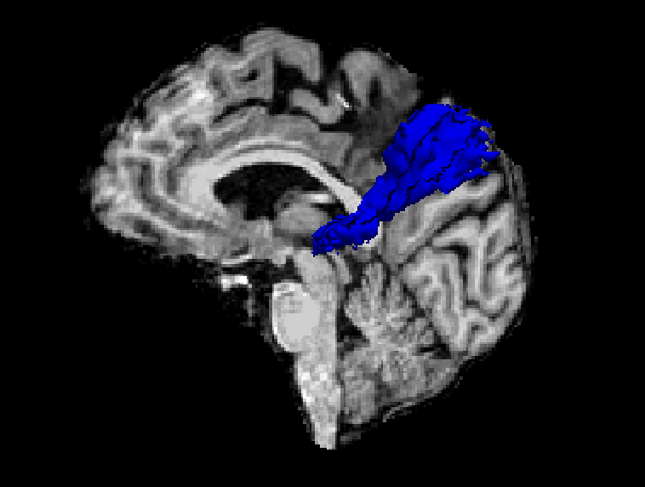
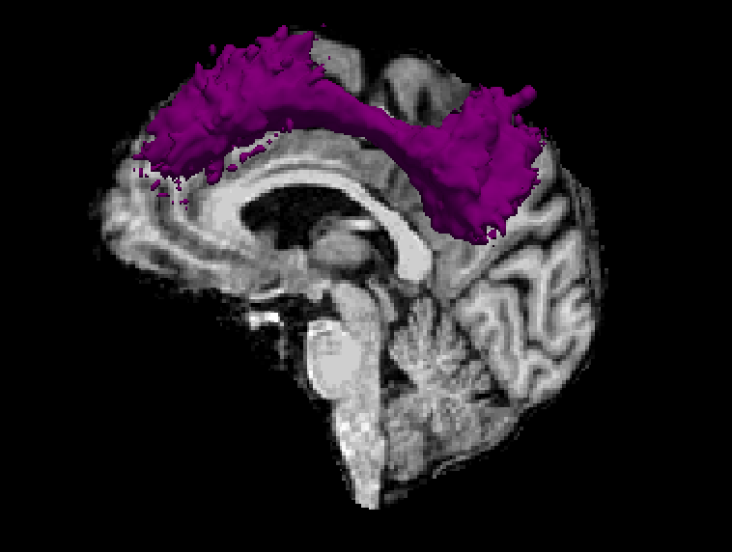
Exploratory Tracts of Interest
Cingulum Bundle - Ventral - Major Input to Hippocampus
- Supports memory, executive function
Cingulum Bundle - Dorsal - Major Input to Hippocampus
- Cognitive control
Notes:
As such, I decided to explore two additional tracts due to their relation to the hippocampus, whose FA values were readily extractable using Freesurfer Tracula.
I was interested in these tracts given their relationship to the hippocampus and hoped that this analysis would provide us with further information about how MBIs might be affecting the hippocampus.
The dorsal and ventral portions of the cingulum bundle, which are major inputs to the hippocampus.

Slide 16
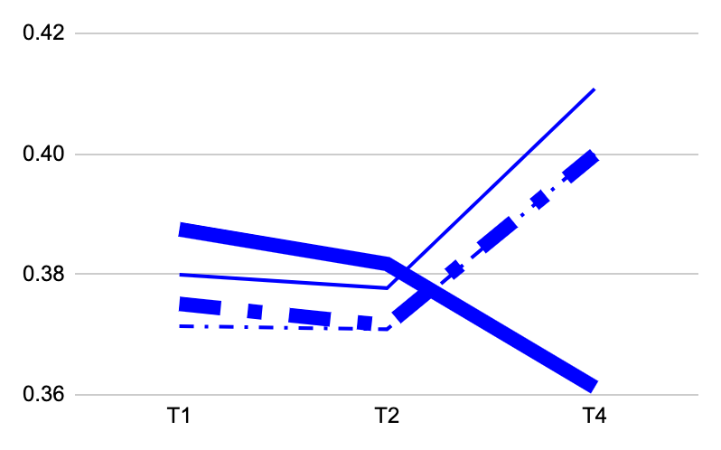
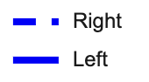
Cingulum Bundle - Ventral
Left GxT
F = 14.902 p = <0.0001
FA Values
Mindfulness
Control
Mindfulness
* Age, Practice time & Baseline FA vals controlled for
Control
Week 0
Week 8
Week 52
Notes:
Within the Ventral portion of the cingulum bundle, I found significant between-group gxt interactions in the LEFT portion, when controlling for baseline FA values, Age, and Practice time.
Omitting the left tract within the mindfulness group, we see a similar pattern to that in the uncinate fasciculus, where we could potentially be seeing pruning from pre- to post-intervention, followed by a significant axonal growth, or the impact of crossing fibers, which might also explain the decrease present in the left tract within the mindfulness group. We could also be seeing the effects of practice time, especially post-training to one year follow-up. During this period, the control group practiced significant more compared to the mindfulness group and this could also explain this significant decrease in the L CBV of the mindfulness group

Slide 17
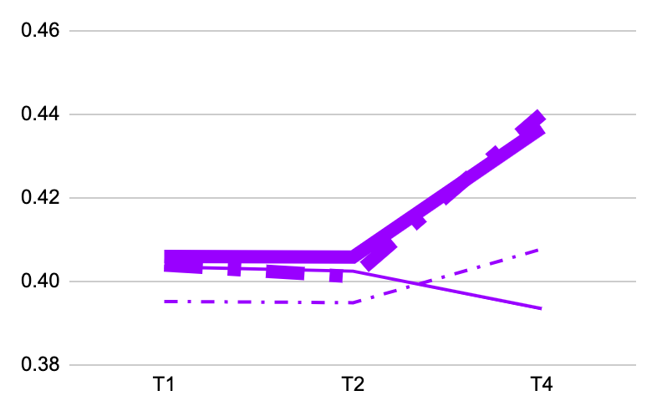
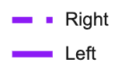
Cingulum Bundle - Dorsal
GxT
Left - F = 10.320 p = 0.0001
Right - F = 10.457 p = 0.001 uuu
ada
FA Values
we
Mindfulness
fjk
Control
* Age, Practice time & Baseline FA vals controlled for
Week 0
Week 8
Week 52
Notes:
Within the dorsal portion of the cingulum bundle, we found bilateral between-group group by time differences when controlling for age, practice time, and baseline FA values. however, there were no significant within-group differences.
In this region, we see this similar trend of initial decreases followed by substantial increases in FA values.

Slide 18
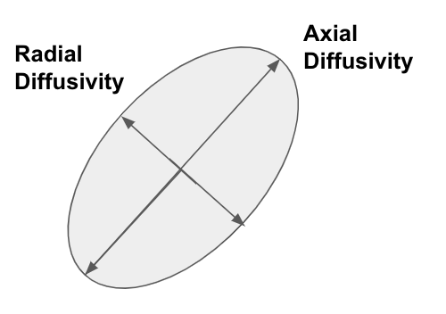
Exploratory Metrics:
Axial Diffusivity (AD) - diffusion parallel to fiber tracts
*Higher values = better integrity*
Radial Diffusivity (RD) - diffusion perpendicular to axonal fibers
*Lower values = better integrity*
Notes:
In order to further understand why significant FA decreases were present post-training, I was also interested in exploring the relationship between measures of working memory and two additional metrics of white matter micro-structrual integrity: Axial and Radial Diffusivity. AD values are a quantification of the magnitude of diffusion parallel to fiber tracts, literature has shown that lower AD values might indicated reduce axonal caliber or less coherent orientations of axons. RD values are water diffusion coefficients in the direction perpendicular to the axonal fibers and are thought to capture differences in axonal myelination. Generally, lower AD and higher RD values are indicative of decreased WM integrity. However, in the context of aging, these metrics have been shown to change differentially depending on the region of interest. I hope that these metrics would provide further insight into changes in WM, not captured by FA values and expected that MT would produce significant increases in AD values and decreases in RD. Furthermore, I was particularly interested in these metrics given a previous study that indicated reduced AD and RD values following meditation training.

Slide 19
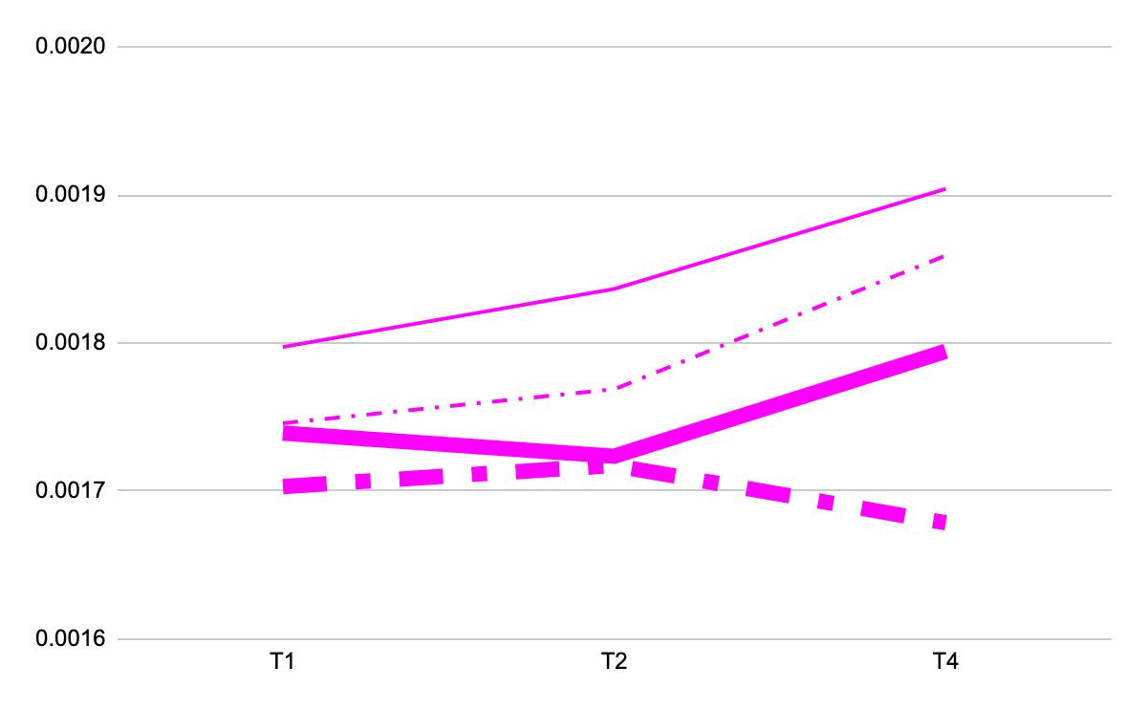
Fornix of Hippocampus
Right GxT
F = 3.36 p = 0.0375u
Better integrity
AD Values
Control
Control
Mindfulness
Mindfulness
* Age, Practice time & Baseline FA vals controlled for
Worse integrity
Week 0
Week 8
Week 52
Notes:
Before getting into the results of the relationship between these diffusion metrics and measures of declarative memory, I want to first quickly show you the significant changes in these metrics within my chosen ROIs.
I first looked at the fornix of the hippocampus. Although there were no GxT interactions in RD values or AD values within the Left fornix of the hippocampus within this region, I identified a significant GxT interaction in the right tract, when controlling for age, practice time and baseline AD values. There was no significant effect of time within-group. ***** are you just referring to right, or all 4 measures? Looks like controls increase significantly. Ok to point this out. Consistent with prior lit
Maybe include mini graphs w FA values at top left if you have time

Slide 20
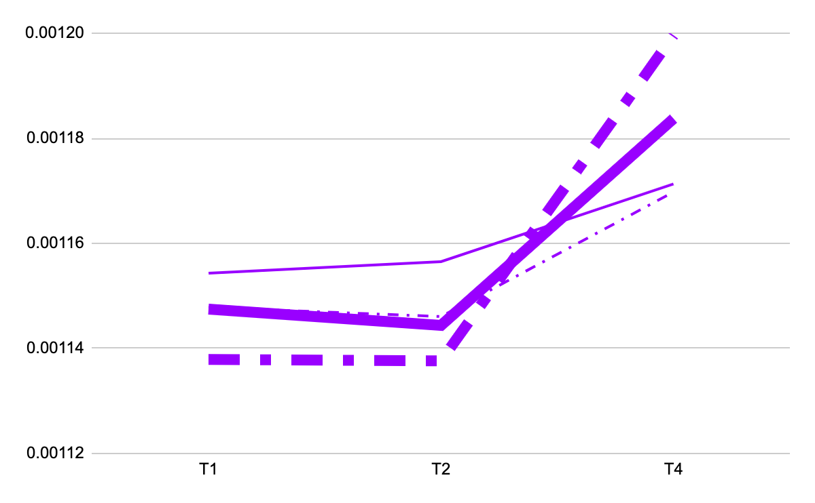
Cingulum Bundle - Dorsal
Right GxT
F = 4.74 p = 0.0102uuu
Better integrity
ada
AD Values
we
Control
Mindfulness
fjk
Mindfulness
* Age, Practice time & Baseline FA vals controlled for
Week 0
Week 8
Week 52
Notes:
Similarly, within the Dorsal portion of the cingulum bundle, there was no GxT relationship between RD values or AD values in the left tract, however there was a significant GxT relationship in the Right tract when controlling for age, practice time, and baseline values.There were no within-group interactions
In these two graphs of AD changes over time, we do see trends that resemble those present in FA values over time. ***Talk about AD first, because that is what is in the graph. Then mention no diff in RD. otherwise they will think that you are talking about RD when you put the slide up
** Should i take out the “worse integrity” since none of the tracks did that? CORRECT -i did it for you

Slide 21
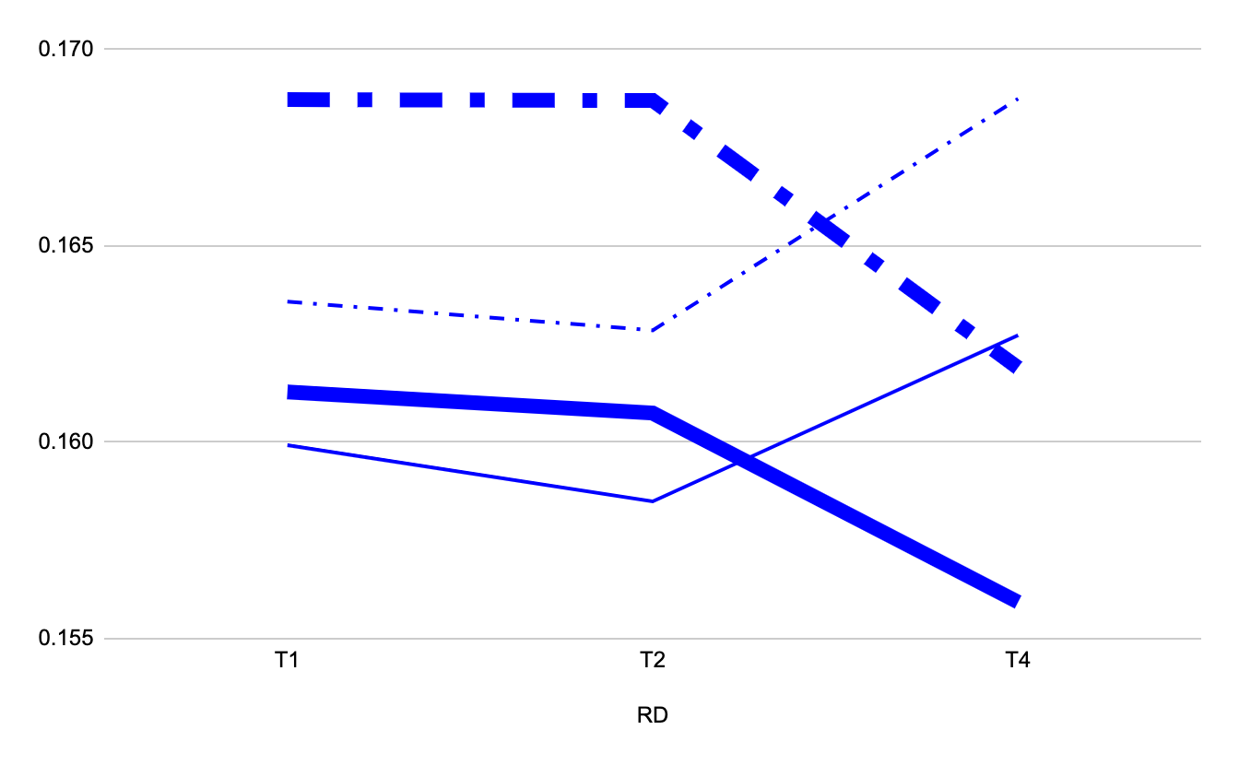
Cingulum Bundle - Ventral
Right GxT
F = 8.96 p = 0.0002
Worse integrity
Mindfulness
RD Values
Control
Mindfulness
Control
Better integrity
* Age, Practice time & Baseline FA vals controlled for
Week 0
Week 8
Week 52
Notes:
Within the Ventral portion of the cingulum bundle, there was no significant GxT interaction in the left tract, however there were significant GxT interactions in the right tract. There were no within-group interactions.
I find this graph really interesting because of this distinctive difference in trends between the mindfulness and control group. In the control group, although we see this initial decrease in RD values, which might suggest an increase in WM integrity, there is also this steep increase in RD values during followup, indicative of poorer WM integrity. Within the mindfulness group, we see an initial increase in RD values??????? NO CHNAGE followed by a substantial decrease in these values during followup, which suggests that the WM in this region increased in integrity during this period. Given that from week 8 to week 52 we saw decreases in declarative memory performance that were significant for the Controls but not the mindfulness group, these results might be suggesting that these differences in RD values are contributing to memory performance and also that RD values might be capturing features of the white matter in this region, not captured by FA values.
*** This begs teh question, why do you not show these tracts in the next section when you talk about MST?

Slide 22
Uncinate Fasciculus
Uncinate Fasciculus | Mindfulness |  | Control
 | Wk 8-Wk 0 | Wk52-Wk8 | Wk8-Wk0 | Wk52-Wk8
Left AD | p = -0.018
Right AD
Both increases & decreases in AD associated with cognitive improvement
Representative of beneficial results given correlation with cognition and significant increases in cognition from week 0 to week 8
Notes:
Now getting into the results investigating the relationship between these changes in diffusion over-time and measures of declarative memory.
Given the distinctive patterns of diffusion changes over time, I decided to look at the relationship between these metrics and DECLARATIVE memory from pre to post intervention and then post-intervention to the one year follow-up period
When looking at the relationship between AD and RD values within the Uncinate fasciculus, I identified a significant negative interaction between AD values in the LEFT uncinate and measures of declarative memory pre- to post- intervention. Although this relationship seems counterintuitive given that it is widely accepted that lower AD values might suggest poorer white matter integrity, some studies have suggested that both increases and decreases in AD values have been associated with cognitive improvements, depending on the white matter tract of interest and thus, it is possible that these changes in Axial diffusivity could be representative of beneficial results, especially given its correlation with cognition and the significant increases in MST scores from pre- to post- intervention.
I also identified a significant negative interaction between RD values in the Right uncinate fasciculus and measures of DECLARATIVE memory performance during the follow-up period. Since we identified increases in FA post intervention and the one year follow-up period AND because RD decreases suggest increases in WM integrity, these results might explain why there was not a significant decrease in MST scores in the mindfulness group between post-intervention and the one year follow up period.

Slide 23
Uncinate Fasciculus
Uncinate Fasciculus | Mindfulness |  | Control
 | Wk 8-Wk 0 | Wk52-Wk8 | Wk8-Wk0 | Wk52-Wk8
Left RD
Right RD |  | p = -0.05
Could explain why there were no significant decrease in cognition in mindfulness group between Week 8 and Week 52
Notes:
I also identified a significant negative interaction between RD values in the Right uncinate fasciculus and measures of DECLARATIVE memory performance during the follow-up period. Since we identified increases in FA post intervention and the one year follow-up period AND because RD decreases suggest increases in WM integrity, these results might explain why there was not a significant decrease in MST scores in the mindfulness group between post-intervention and the one year follow up period.

Slide 24
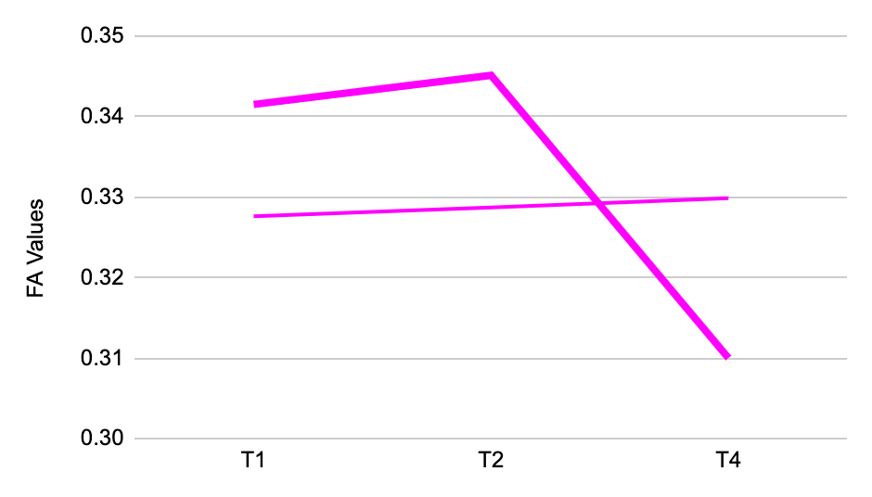
Fornix of the Hippocampus
Hippocampal Fornix | Mindfulness |  | Control
 | Wk8-Wk0 | Wk52-Wk8 | Wk8-Wk0 | Wk52-Wk8
Left RD | p = -0.053 | p = 0.007
Right RD
Decreases in RD, indicating increased integrity, related to increases in cognitive performance
Decreases in RD between Wk 8 and Wk 52 might contribute to slower rate of memory decline in Mindfulness group
Notes:
I finally looked at the relationship between RD and AD values within the fornix of the hippocampus and measures of DECLARATIVE memory. Although there were no relationships identified in AD values, I did identify a significant relationship between DECLARATIVE memory and RD values in the LEFT fornix both during the intervention and between post-intervention and the one year follow up period.
From pre- to post- intervention there were significant increases in DECLARATIVE memory, which showed a linear relationship with decreases in Radial diffusivity, which is generally accepted to indicate increases in integrity. So this is consistent with most other studies of training related changes in WM. Whereas from post-intervention to the one year follow-up, we see a positive interaction between decreases in DECLARATIVE memory and decreases in RD values. Although counter-intuitive, this finding might contribute to the slower rate of memory decline in the meditation group compared to controls. Thus, these results also support the idea that RD values are capturing important information about changes in white matter that promote cognition, not captured by FA values.

Slide 25
Conclusions:
-Hippocampal WM tracts are modified by Mindfulness Training in healthy older adults
-Memory improvements in each group are associated with different diffusion metrics
-Mindfulness-related changes in both the fornix and uncinate fasciculus contribute to enhanced declarative memory
-Other neuroimaging modalities are needed to clarify cellular level changes contributing to FA, i.e. crossing fibers vs. pruning, etc.
Notes:
In conclusion, I was interested in exploring the effect of mindfulness training on major white matter tracts associated with the hippocampus, given a significant number of studies suggesting that MBIs effect this region both structurally and functionally.
These results indicate that mindfulness training does in fact impact wm integrity in major white matter tracts within the hippocampus and promote cognitive performance, although the exact mechanisms through which these two variables are related merits further exploration.
Notably, although we see memory improvements in both groups pre- to post- intervention, these improvements are associated with different diffusion metrics. Although our results are somewhat confusing, this is typical for the cog training literature, in general. Even when compared in the same study, different types of cog training are associated with distinct patterns of WM changes, and the inter-relationship between FA, AD and RD is not always consistent with what is seen in cross-sectional aging studies.
We identified mindfulness-related changes in both the the fornix and uncinate fasciculus that contributed to enhanced declarative memory suggesting that MT might have significant benefits for cognitive interventions designed to slow age-related cognitive decline
Given that this is one of the few investigations into the impact of mindfulness training on white matter integrity and the ambiguous explanations for FA decreases, future research which implements other neuroimaging modalities are needed to clarify cellular level changes contributing to FA such as crossing fibers and pruning.

Slide 26
Acknowledgements:
Lazar Lab
Additional Collaborators
Harold Roth, PhD*
Bonnie Wong, PhD
Bradford Dickerson, MD
David Salat, PhD
Sara Lazar, PhD*
Gunes Sevinc, PhD
Burak Cindik
Cade Herrera
Rob Kaufman
Tanya Datta

Slide 27




M4: Mindfulness Mechanisms
and Methods Meeting
OCTOBER 5-6, 2023
www.mindfulnessmechanisms.org

Slide 28
Thank you :)
Questions or Comments?
Contact: Elizabeth_Kaplan@Brown.edu

